Slide 1
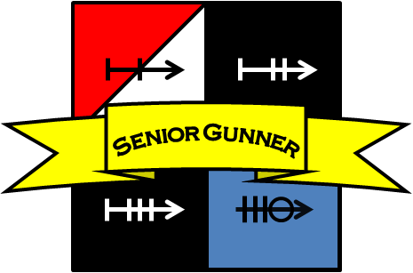
SENIOR GUNNER COURSE STUDENT READ-AHEAD

Slide 2
Welcome to 964-SGC or the Senior Gunner Course. You are about to begin a 12 day course that is built to saturate candidates with information. Students will be required to learn, retain and perform skills at various test points throughout the course.
It is very important that students do not fall behind by being required to retake tests. Statistically, students that fall behind will struggle if not, fail the course altogether.
The following is a “read-ahead” guide that will build a base of knowledge for a Senior Gunner Candidate in order to give them a better chance at success during the course.
It is broken down into sections.
2

Slide 3
The first section is selected chapters from TC 3-20.31-4, Direct Fire Engagement Process and TC 3-20.31, Training and Qualification, Crew. Reading prior to the beginning of the course will ease understanding during instruction. All of the chapters listed for reading are covered on Day 1-3 of the Senior Gunner Course.
These chapters make up a large amount of the first test point—three 10-question written exams where students must achieve 80% or better on each without references.
The last section covers parts of the Gunnery Skills Test tasks that each student must master in order to graduate the course.
3

Slide 4
Task 2 of the Gunnery Skills Test is the Threat/Friendly, Theater Specific Vehicle Identification.
Listed will be the “Action/Condition/Standard” for each task as well as all steps required to perform the tasks to that standard.
Students will receive a block of instruction for vehicle identification, but knowing the vehicles prior to the beginning of the course will give students a much better chance of passing the test on Day 7.
4

Slide 5
Tasks 3, 5, 6, 8, 9 and 11 of the Gunnery Skills Test are weapons tasks.
Listed will be the “Action/Condition/Standard” for each task as well as all steps required to perform the tasks to that standard.
Students will NOT receive a block of instruction for weapons. Depending on the availability of the classes’ weapons, students will need to utilize after- class hours to brush up on these 10-level tasks. Knowing the performance steps prior to the beginning of the course will give students a much better chance of passing the test on Day 7.
5

Slide 6
Chapter 4 ENGAGE ............................................................................................................ 4-1
Section I – Principles of Direct Fire .................................................................................. 4-1
Mass the Effects of Fire ....................................................................................................... 4-2
Destroy the Most Dangerous Threat First ............................................................................ 4-2
Avoid Target Overkill ............................................................................................................ 4-2
Employ the Most Appropriate Weapon ................................................................................. 4-2
Minimize Friendly Exposure and Avoid Fratricide .................................................................4-2
Plan for Extreme Limited Visibility Conditions ...................................................................... 4-3
Develop Contingencies ........................................................................................................ 4-3
Section II – Types of Fire Commands .............................................................................. 4-5
Section III – Elements of a Fire Command ....................................................................... 4-7
Alert ..................................................................................................................................... 4-9
Weapon or Ammunition ........................................................................................................ 4-9
Description (Target Description) ........................................................................................... 4-9
Direction or Elevation ........................................................................................................... 4-9
Range .................................................................................................................................. 4-9
Method ................................................................................................................................ 4-9
Controls ............................................................................................................................... 4-9
Execution ............................................................................................................................ 4-9
Termination .......................................................................................................................... 4-10
Section IV – Fire Command Terms ................................................................................... 4-10
Response............................................................................................................................. 4-10
Sensing/Assessment ........................................................................................................... 4-10
Modifiers .............................................................................................................................. 4-10
Clarification .......................................................................................................................... 4-10
Movement ............................................................................................................................ 4-10
Appendix A CREW CONDUCT OF FIRE .............................................................................. A-1
READ THE SELECTED CHAPTERS FROM
TC 3-20.31-4
This publication is available at Army Knowledge Online (https://armypubs.us.army.mil/doctrine/index.html).
6

Slide 7
READ THE SELECTED CHAPTERS FROM
TC 3-20.31
Chapter 5 CREW TABLES................................................................................5-1
Section I – Prerequisite Crew Tables..............................................................5-1
Table I – Gunnery Skills Test..............................................................................5-1
Table II – Simulations..........................................................................................5-2
Table III – Proficiency..........................................................................................5-2
Section II – Live fire Crew Tables....................................................................5-3
Table IV – Basic ..................................................................................................5-3
Table V – Practice...............................................................................................5-4
Table VI – Qualification.......................................................................................5-5
Section III – Qualification Standards...............................................................5-6
Crew Ratings.......................................................................................................5-6
Qualification Refires............................................................................................5-6
Section IV – Crew Management.......................................................................5-8
This publication is available at Army Knowledge Online (https://armypubs.us.army.mil/doctrine/index.html).
To receive publishing updates, please subscribe at http://www.apd.army.mil/AdminPubs/new_subscribe.asp
7

Slide 8
Chapter 6 CREW EVALUATION.......................................................................6-1
Section I – Vehicle Crew Evaluators ...............................................................6-1
Vehicle Crew Evaluator Team Composition .......................................................6-1
Evaluator Roles and Prerequisites......................................................................6-2
Vehicle Crew Evaluator’s Certification................................................................6-6
Section II – Evaluation Terms and Concepts .................................................6-7
Threat-Based Methodology.................................................................................6-7
Threat Levels ....................................................................................................6-11
Target Delays....................................................................................................6-12
Target Lock .......................................................................................................6-12
Active Targets ...................................................................................................6-14
Target Kill Standards.........................................................................................6-14
Mechanical Malfunctions...................................................................................6-16
Annotating Firing Events...................................................................................6-19
Section III – Evaluation Timing......................................................................6-22
Exposure Time..................................................................................................6-23
Engagement Time.............................................................................................6-23
Break Time........................................................................................................6-23
Alibi Process .....................................................................................................6-30
Section IV – Evaluating the Crew’s Duties ...................................................6-32
Crew Penalties ..................................................................................................6-32
Application of Penalties.....................................................................................6-39
Disqualification Criteria and Recertification ......................................................6-39
Section V – Common Crew Score Sheet ......................................................6-40
Header Information (Admin)..............................................................................6-40
Engagement Information...................................................................................6-42
Task / Engagement Events...............................................................................6-43
Engagement Modifier ........................................................................................6-46
Example Score sheet ........................................................................................6-48
Section VI – Additional Tasks........................................................................6-49
READ THE SELECTED CHAPTERS FROM
TC 3-20.31
This publication is available at Army Knowledge Online (https://armypubs.us.army.mil/doctrine/index.html).
To receive publishing updates, please subscribe at http://www.apd.army.mil/AdminPubs/new_subscribe.asp

Slide 9
The following tasks are taken from Ch. 8, TC 3-20.31-1 and ROC-V.
This publication is available at Army Knowledge Online (https://armypubs.us.army.mil/doctrine/index.html).
To receive publishing updates, please subscribe at http://www.apd.army.mil/AdminPubs/new_subscribe.asp
https://rocv.army.mil/
9

Slide 10
THREAT/FRIENDLY/THEATER-SPECIFIC VEHICLE IDENTIFICATION
ACTION
Properly identify threat/friendly/theater-specific vehicles.
CONDITION
Given vehicles from the Recognition of Combat Vehicles (ROC-V) database, computer, projector, approved slideshow of vehicles.
STANDARD
Within time and without references, the Soldier must identify 40 of 50 threat/friendly vehicles and helicopters by nomenclature. All friendly equipment must be identified correctly to receive a GO rating.
50 vehicles (25 day/25 thermal) 25 thermal (20/25 must be enemy) 4 x rotary.
8 x tracked.
4 x wheeled armored. 4 x wheeled unamored. 5 x unit-specified.
Note. Same vehicles can be used in the day and at night.
Test Planning Time
Administrative time: 5 minutes Test time: 16 minutes, 40 seconds
Total time: 21 minutes, 40 seconds
Instructions to the Crewmember
“The purpose of this test is to evaluate your ability to recognize threat/friendly vehicles. You must correctly identify 40 of 50 threat vehicles and helicopters by nomenclature. You must correctly identify all friendly vehicles to receive
a GO rating. Each vehicle will be exposed for 10 seconds, with 10 seconds between exposures to write your answer
on your checklist. Do you understand the requirements of this test?” (Answer questions.) “You may begin.” (Show
the first slide, mock-up, drawing, or model, and start the time.)

Slide 11
4 x rotary:
MI 24 HIND
MI 8 HIP
AH 64 Apache
UH 60 Blackhawk
4 x wheeled armored:
BRDM 2
BTR 70
BTR 80
SA-9 Gaskin
8 x tracked:
BMP 2
BMP 3
MT-LB
T 54/55
T 72
T 80
2S1 Gvozdika
ZSU 23-4 Shilka
4 x wheeled unarmored:
UAZ-469
URAL-375D
BM-21 GRAD
KRAZ 260
5 x unit-specified:
M2 Bradley
Abrams
Stryker
SA-13 Gopher
BTR-152

Slide 12
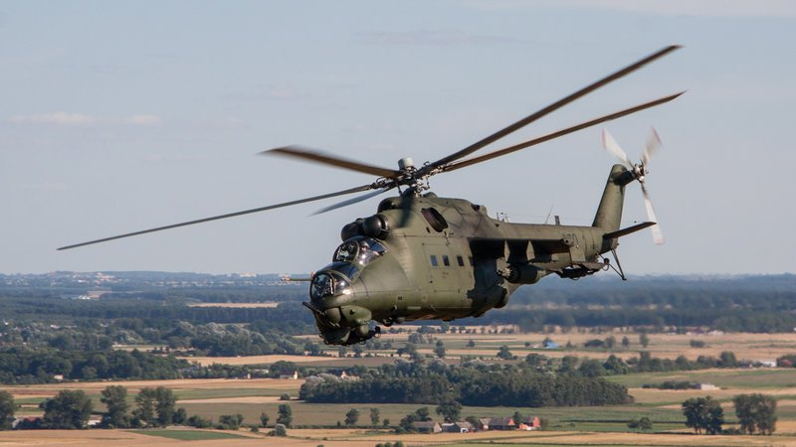
MI 24 HIND
Side exiting exhaust
“Double Bubble” cockpit
Large wings for attachment of armament

Slide 13
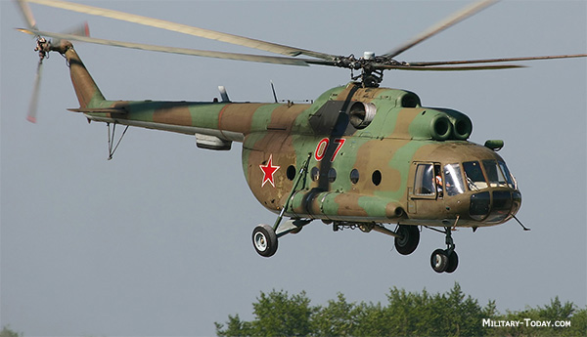
MI 8 HIP
3 Air Intakes
Thin tail section
Fixed Landing gear

Slide 14
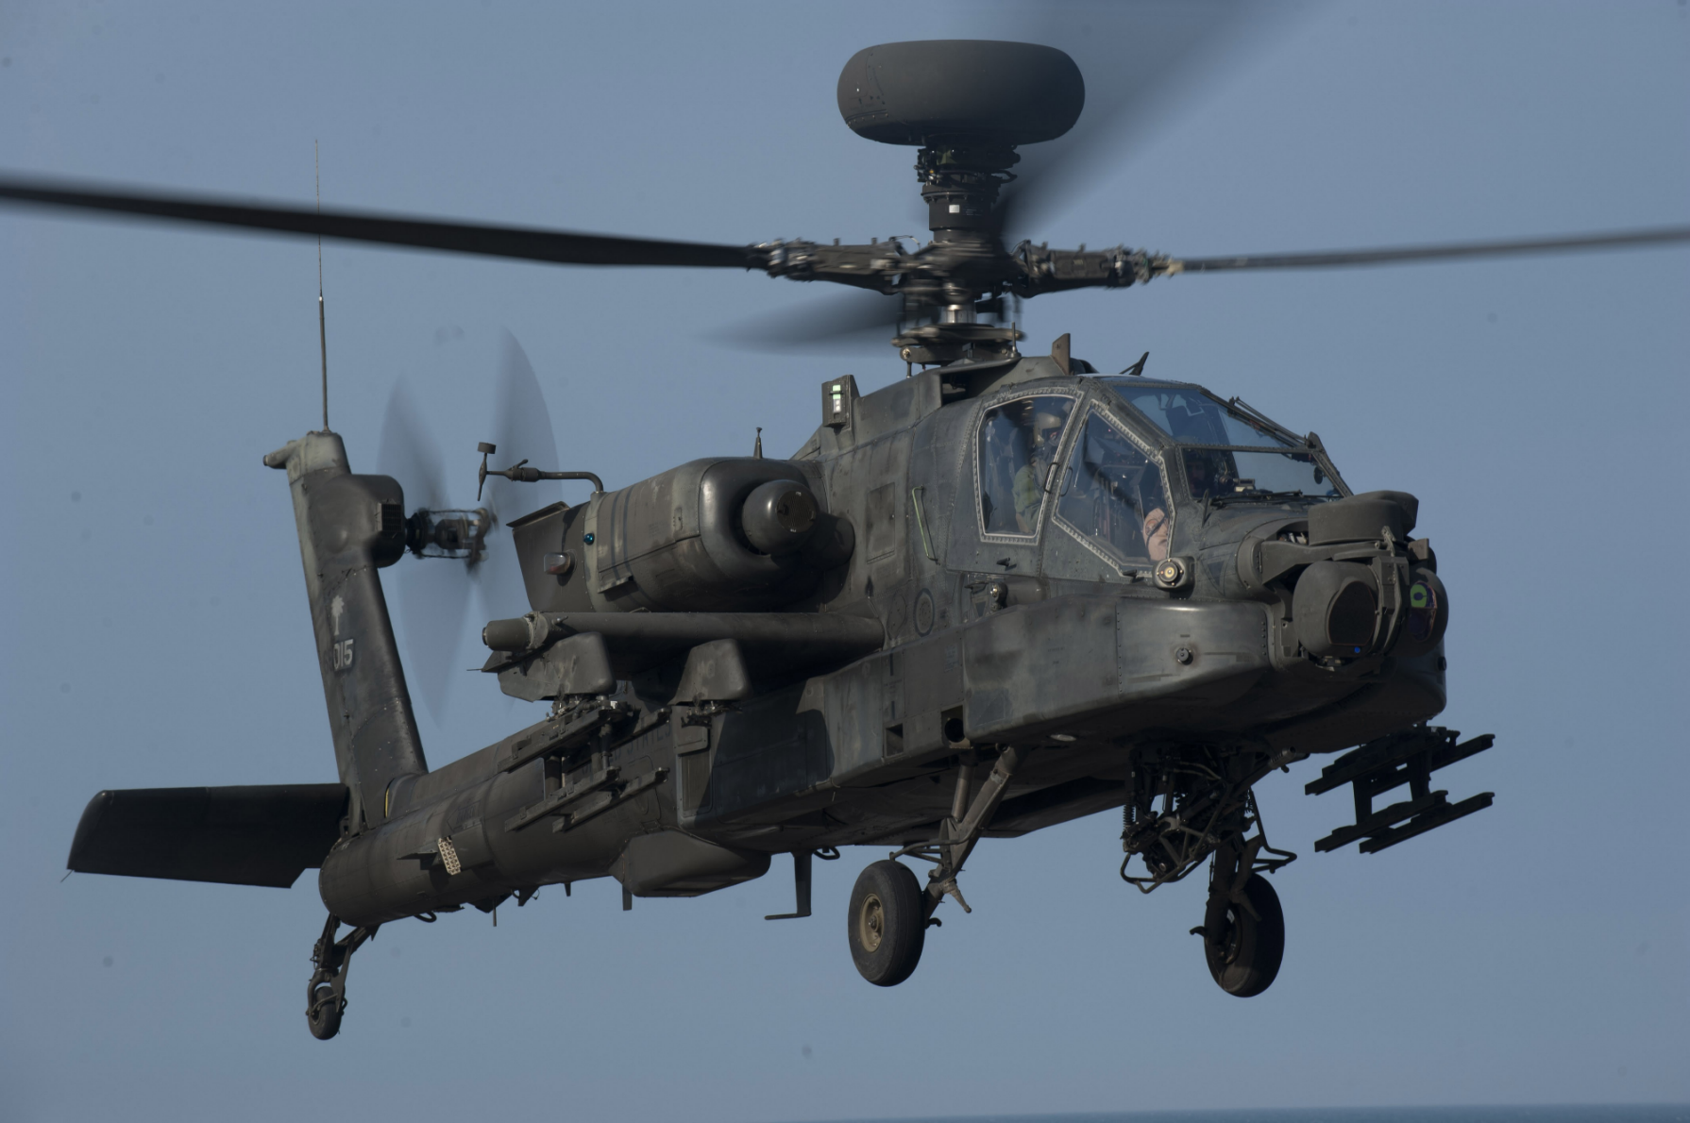
AH 64 Apache

Slide 15
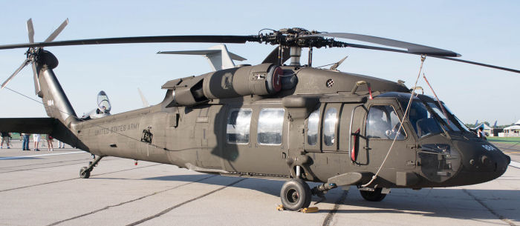
UH 60/Blackhawk
Fuselage tappers downwards into the tail assembly
Large rear Stabilizer
Fixed landing gear

Slide 16
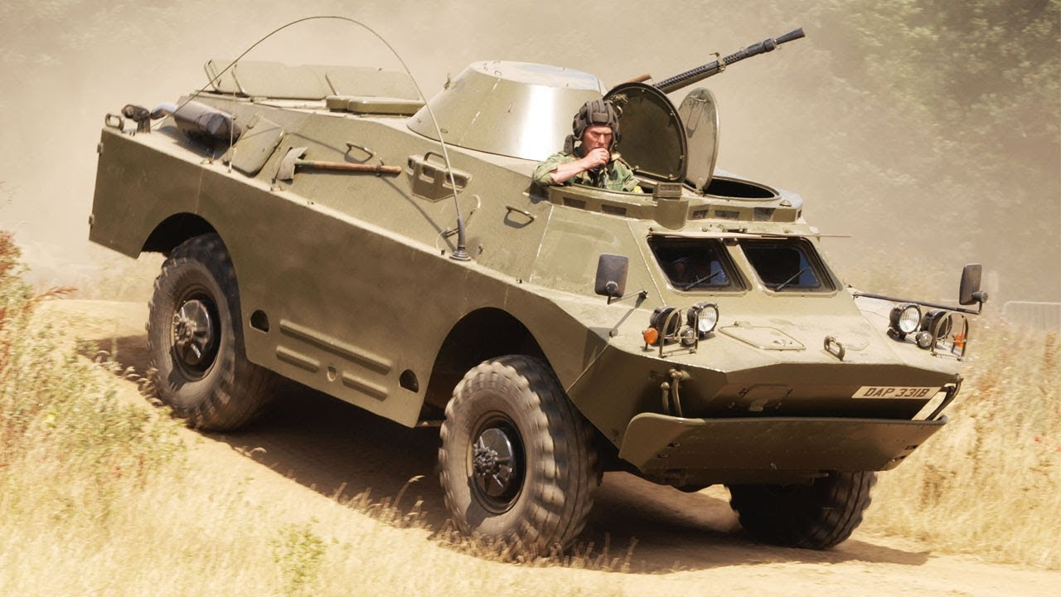
BRDM 2
Pan-shaped turret center of the vehicle
Two distinct foot holes

Slide 17
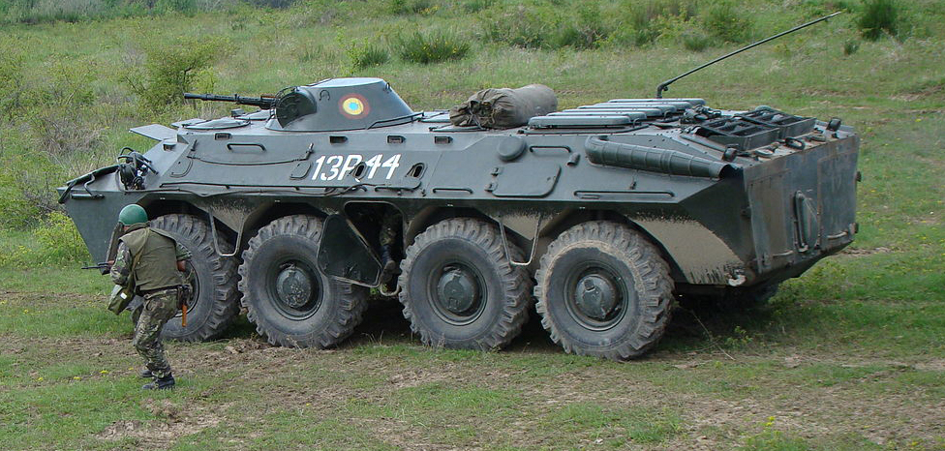
BTR 70
Short infantry rail
Angled exhaust
Troop door opens downward only

Slide 18
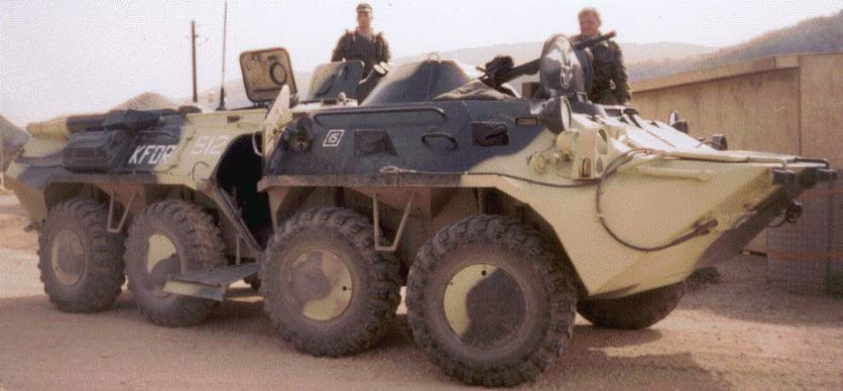
BTR 80
Troop door opens upward and downward
Exhaust parallel with the ground
Long infantry rail

Slide 19
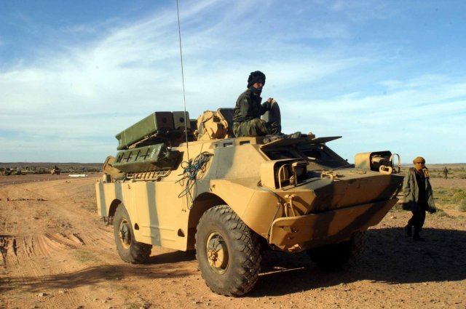
SA-9 Gaskin
Surface to air missiles can be raised and lowered
Two distinct foot holes

Slide 20
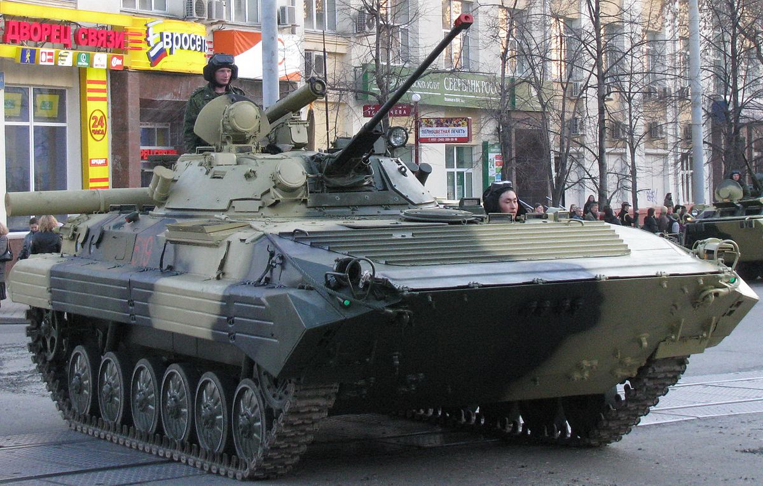
BMP 2
Pan shaped turret
Rubber side skirts
Bullet deflectors

Slide 21
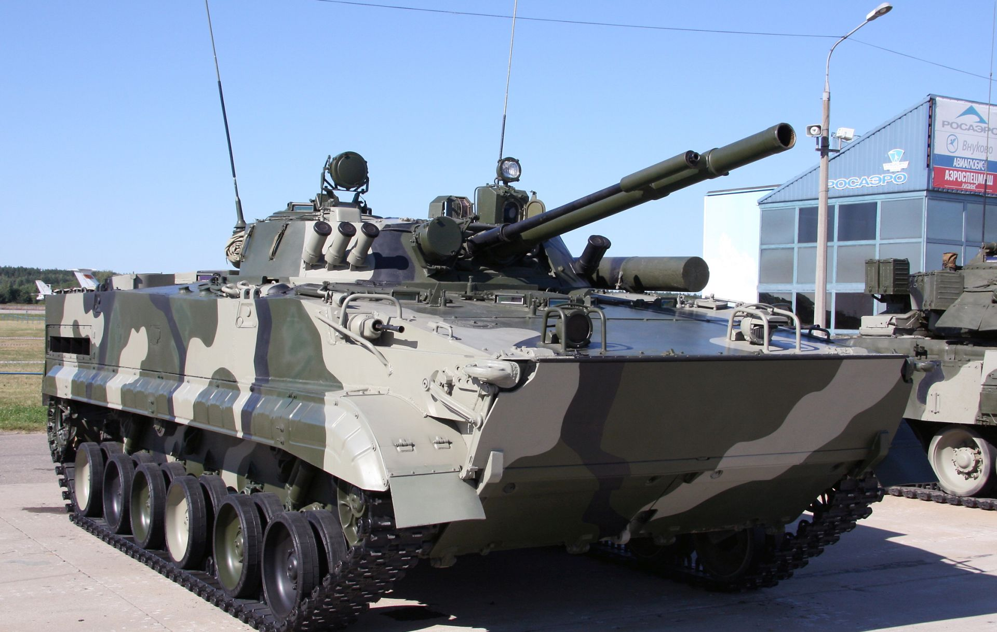
BMP 3
Dual mounted 100mm/30mm
2 bow gunners

Slide 22
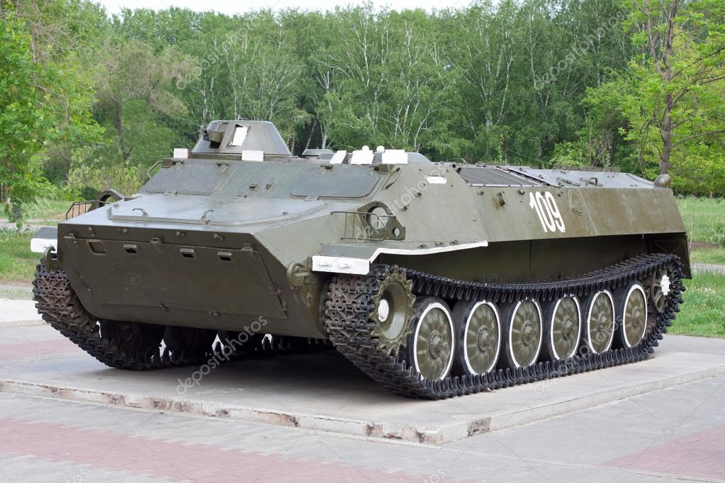
MTLB
Small turret
Un-supported suspension, 6 road wheels, very low profile

Slide 23
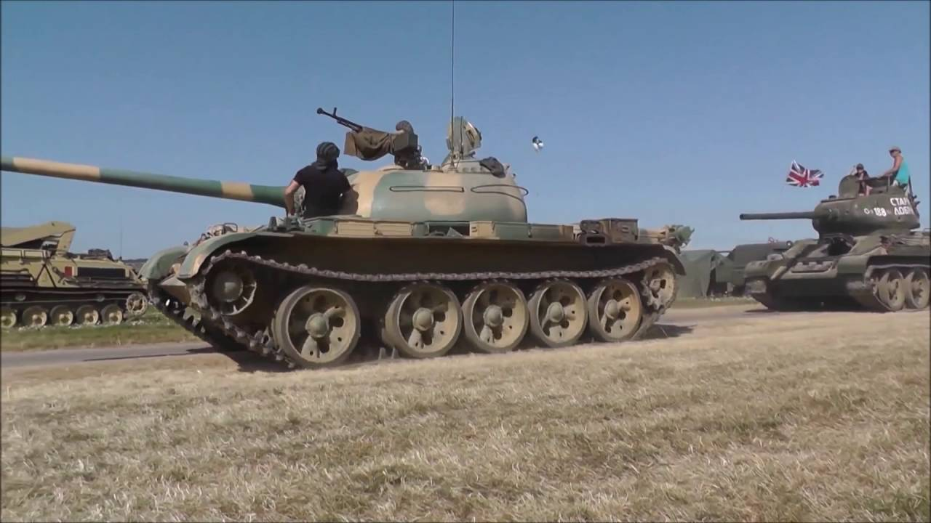
T 54/55
Mushroom like turret
Two distinctive troop rails;
one straight and one bowed
Five large cast road wheels with a gap between #1 and #2
Notes:
Presenter
2017-05-24 15:14:17
--------------------------------------------
Mushroom like turret shape
Bore evacuator at end of 100mm guntube
Two distinctive troop rails one straight and one bowed Five large cast road wheels with a gap between #1 and #2

Slide 24
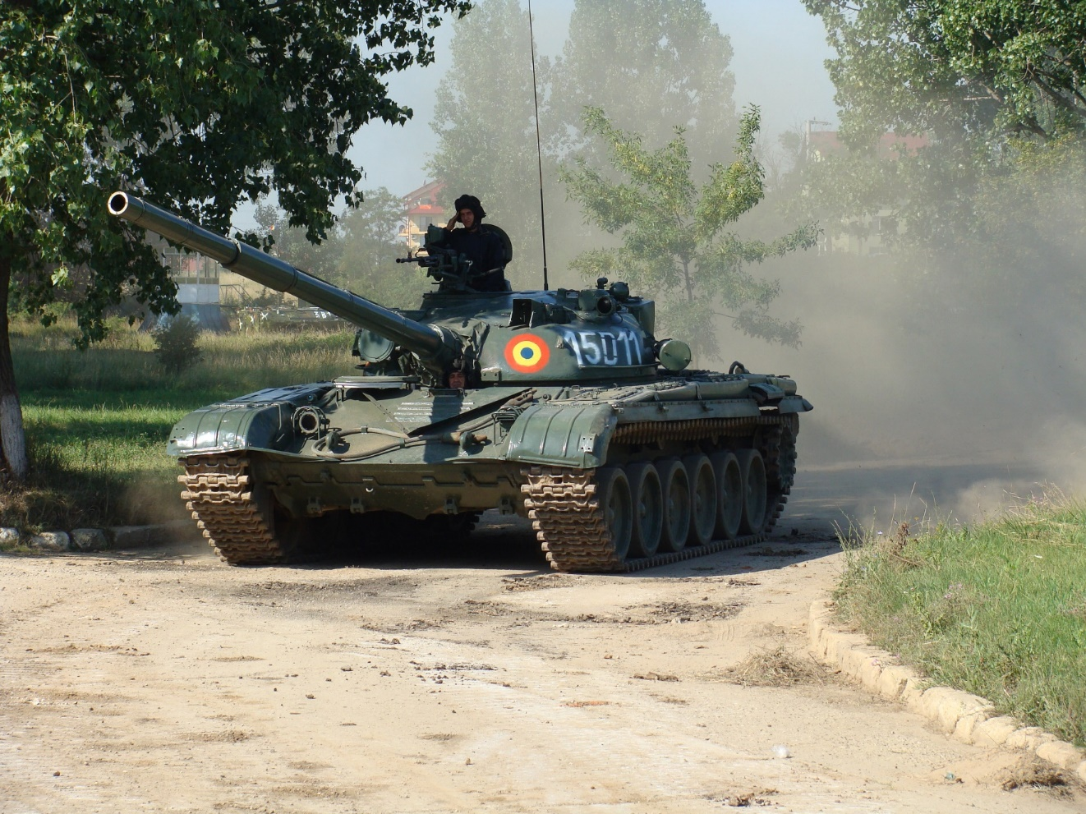
T 72
Bore evacuator 1/3 back
Distinct “V” on front deck
Six large cast road wheels with a gap between #1 and #2
Notes:
Presenter
2017-05-24 15:14:18
--------------------------------------------
Seven evenly spaced road wheels Recessed gunners sight
Wavy skirts

Slide 25
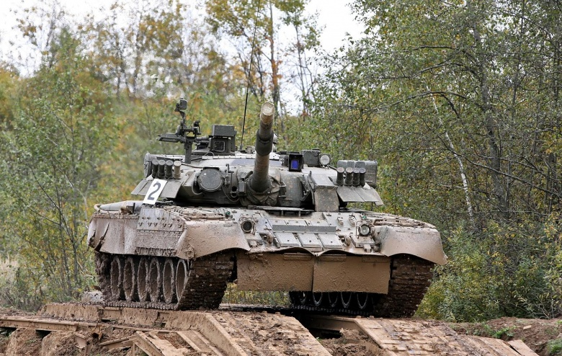
T 80
Turret overhang with
stand-off skirts in
frontal arc
Bore evacuator 1/3 back
Wavy front skirt
and “6 pack” reactive armor
Notes:
Presenter
2017-05-24 15:14:17
--------------------------------------------
Die cast road wheels spaced in groups

Slide 26
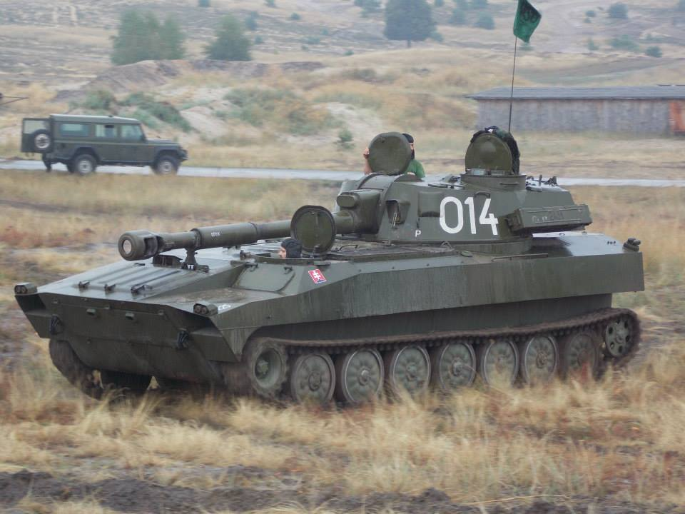
2S1 Gvozdika
Turret sits to rear with 122mm howitzer in front
Driver left side of vehicle unlike most tanks
Seven stamped road wheels with unsupported track
Notes:
Presenter
2017-05-24 15:14:18
--------------------------------------------
Seven evenly spaced road wheels Recessed gunners sight
Wavy skirts

Slide 27
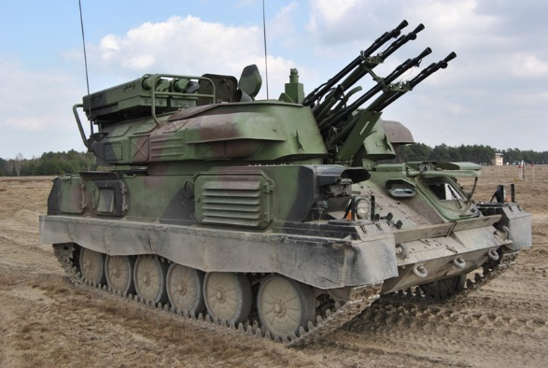
ZSU 23-4 Shilka
Four 23mm anti-aircraft autocannons, hence the name
Six stamped road wheels with rear sprocket
Notes:
Presenter
2017-05-24 15:14:18
--------------------------------------------
Seven evenly spaced road wheels Recessed gunners sight
Wavy skirts

Slide 28
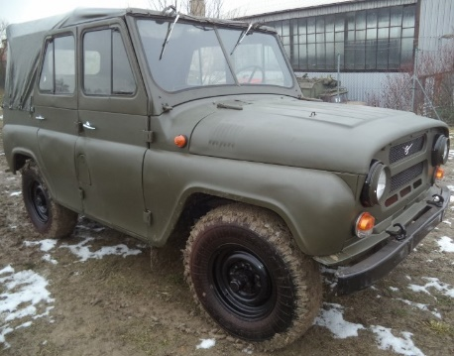
UAZ-469
Off-road light utility vehicle

Slide 29
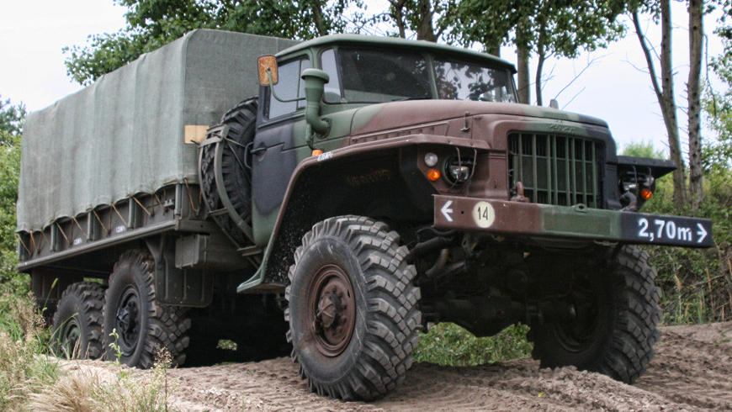
Ural-375D

Slide 30
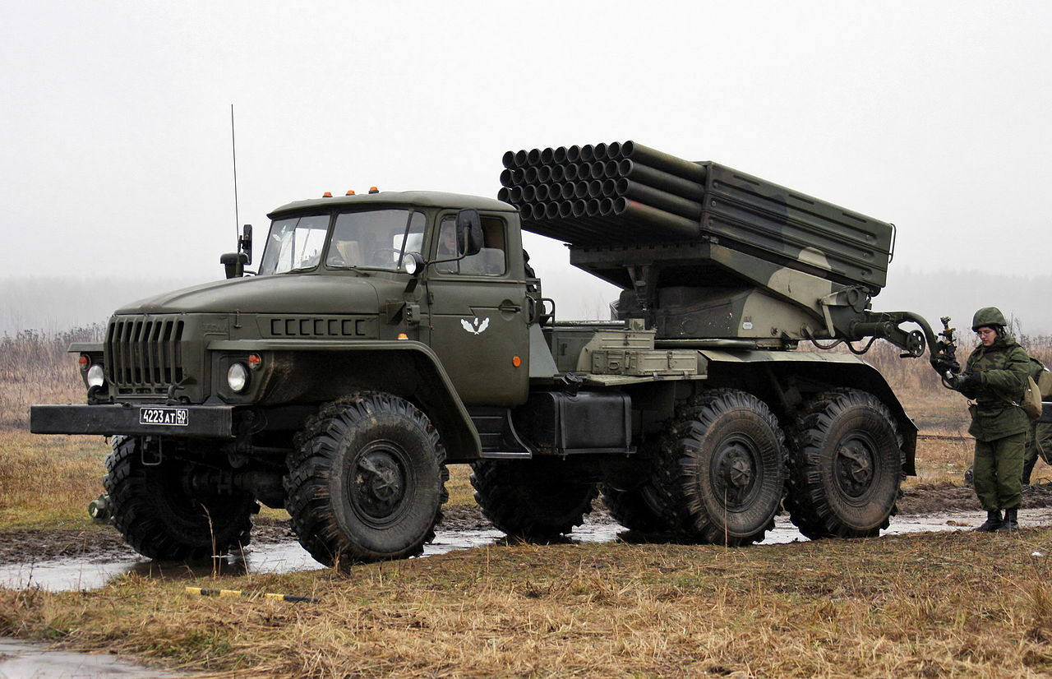
BM-21 GRAD
40 122mm multiple rocket launcher system

Slide 31
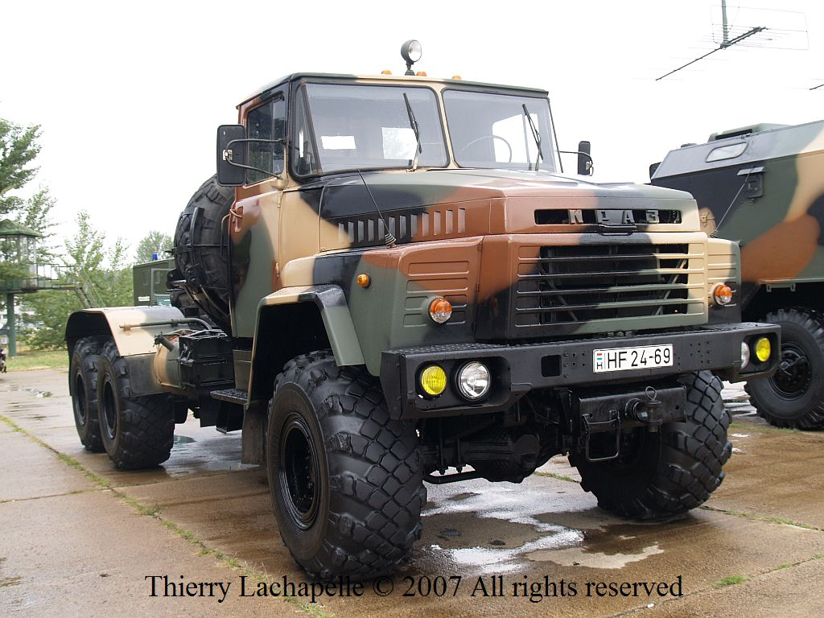
KRAZ 260
Off-road 6X6 tractor with fender over rear wheels

Slide 32
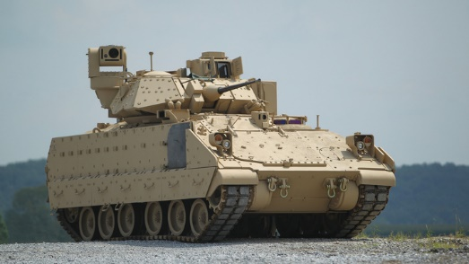
Bradley
TOW launcher
6 road wheels with a space between #3 & #4
Driver’s hatch in flat portion of hull

Slide 33
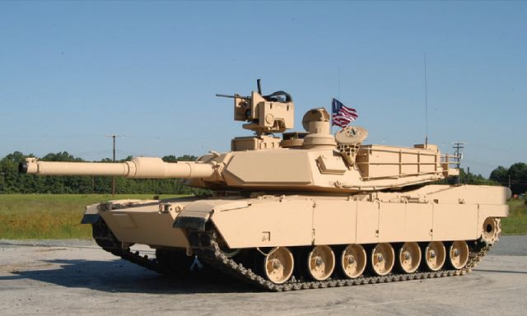
Abrams
Cutout on both sides of turret
7 road wheels with a space between #1 & #2

Slide 34
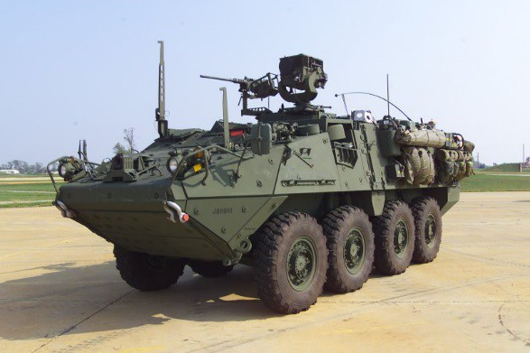
Stryker
6 road wheels with a space between #3 & #4

Slide 35
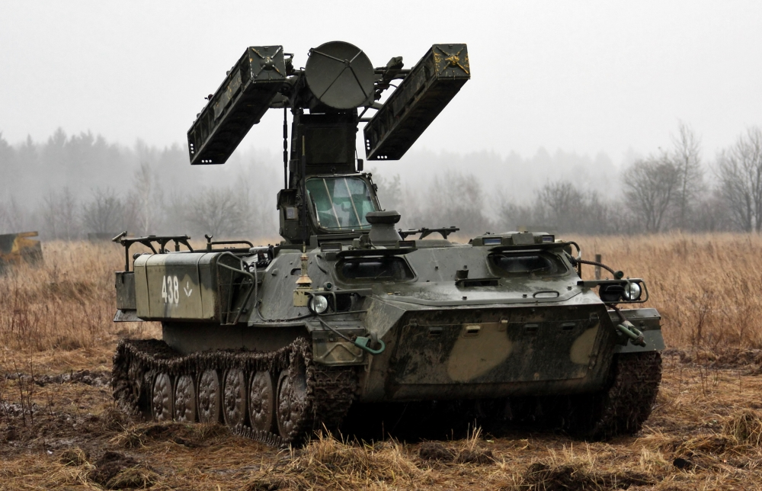
SA-13 Gopher
MTLB chassis with surface to air missiles

Slide 36
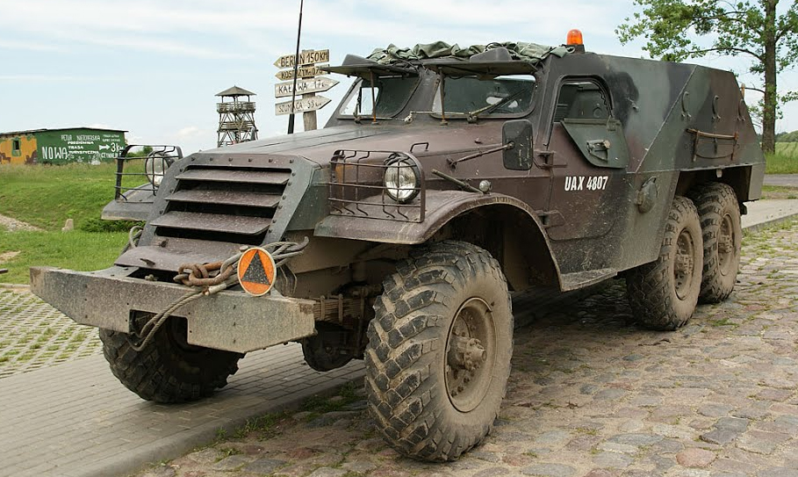
BTR-152

Slide 37
TASK 3
CLEAR, DISASSEMBLE, ASSEMBLE, AND PERFORM FUNCTION CHECK ON A MK19 40MM GRENADE MACHINE GUN ACTION
Clear, disassemble (fieldstrip), assemble, perform a function check on a MK19 40mm grenade machine gun.
CONDITION
Given a MK19 grenade machine gun mounted on a M3 tripod, 10 rounds of linked dummy 40mm ammunition, and FM 3- 22.27.
STANDARD
Within eight minutes and without references, the crewmember will—
-Clear (in sequence).
-Disassemble.
-Assemble.
Perform a function check (in sequence).

Slide 38
PERFORMANCE CHECKLIST FOR TASK 3
CLEAR, DISASSEMBLE, ASSEMBLE, AND PERFORM FUNCTION CHECK ON A MK19 40MM GRENADE MACHINE GUN
1.
a.
b.
c.
d.
e.
f.
g.
h.
i.
j.
k.
l.
Cleared (in sequence).
Moved the safety switch to the S (safe) position. Opened the top cover.
Charged the weapon.
Returned charging handles forward, leaving one handle down. Removed the rounds from the feed tray.
Used the cleaning rod to force the live round/empty casing off the face of the bolt and caught the live round. Lowered and pulled both charging handles to the rear.
Inspected the chamber and bolt face.
Moved the safety switch to the F (fire) position.
Maintained rearward pressure on the charging handles, pressed the triggers and allowed the bolt to ease forward. Moved the safety switch to the S (safe) position.
Moved the secondary drive lever to the right.

Slide 39
2.
a.
b.
c.
d.
e.
f.
g.
h.
i.
j.
k.
Disassembled. 3.
Removed the bolt and backplate assembly. a.
Removed the secondary drive lever. b.
Removed the heat shield. c.
Removed the feed slide assembly. d.
Removed the feed tray. e.
Removed the primary drive lever and vertical cam. f. Removed the alignment guide assembly. g.
Removed the ogive plunger. h.
Removed the round-positioning block. i.
Assembled.
Assembled the sear housing assembly.
Assembled the left- and right-hand charger assemblies Assembled the round positioning block.
Inserted the ogive-plunger assembly. Inserted the alignment guide assembly. Attached the vertical cam.
Attached the primary drive lever. Attached the feed tray.
Attached the feed slide assembly.
Attached the top cover assembly.
Attached and engage the secondary drive lever. Inserted the bolt and backplate assembly.
Removed the left- and right-hand charger assemblies. j.
Removed the sear housing assembly.
k.
l.

Slide 40



4.
a.
b.
c.
d.
e.
f.
g.
h.
i.
j.
k.
l.
5.
Performed a function check (in sequence).
Closed the top cover.
Moved the safety switch to the S (safe) position. Charged the weapon.
Locked the charging handles forward.
Pressed the trigger. (The bolt should not have movedforward.) Moved the safety switch to the F (fire) position.
Pressed the trigger. (The bolt should have sprungforward.) Moved the safety switch to the S (safe) position.
Opened the top cover.
Ensured the firing pin is exposed. Moved the feed slide to the left. Closed the top cover.
Completed all steps within eight minutes.

Slide 41
TASK 5
LOAD, ATTEMPT TO FIRE, APPLY IMMEDIATE ACTION, AND UNLOAD A PINTLE-MOUNTED MK19 MOD 3, 40MM GRENADE MACHINE GUN
ACTION
Load, attempt to fire, apply immediate action, and unload a pintle-mounted MK19 Module (MOD) 3, 40mm grenade machine gun.
CONDITION
Given a fully operational pintle-equipped Stryker with basic issue items (BII), MK19 MOD 3, 40mm grenade machine gun cleared and mounted, allocated 40mm dummy ammunition, and FM 3-22.27; TM 9-2355- 311-10-7-1; TM 9-2355-311-10-7-2; and TM 9-2355-311-10-7-3. The weapon has been cleared for testing purposes.
STANDARD
Within five minutes and without references, the crewmember will—
-Load.
-Attempt to fire.
-Apply immediate action.
-Unload.

Slide 42
PERFORMANCE CHECKLIST FOR TASK 5 LOAD, ATTEMPT TO FIRE, APPLY IMMEDIATE ACTION, AND UNLOAD MK19MOD 3, 40MM GRENADE MACHINE GUN
1.
a.
b.
c.
d.
e.
f.
g.
h.
i.
j.
k.
l.
m.
n.
2.
Loaded (in sequence).
Moved the safety switch to the S (safe) position. Opened the top cover.
Ensured the bolt is forward.
Inserted the rounds, female link first, through feed throat. Inserted first round into feeder and across the first pawl.
Moved the feed slide assembly to the left. Closed the top cover.
Charged the weapon.
Locked the charging handles forward and up. Moved the safety switch to the F (fire) position.
Pressed the triggers. (The bolt should have sprungforward.) Charged the weapon.
Locked the charging handles in forward and up position. Moved the safety switch to the S (safe) position.
Completed all steps within two minutes.

Slide 43

3.
a.
b.
c.
d.
e.
f.
g.
4.
5.
a.
b.
c.
d.
e.
f.
g.
Performed immediate action (in sequence).
Placed weapon on FIRE. Attempted to fire weapon. Announced, “MISFIRE.” Waited 10 seconds.
Pulled the bolt to the rear and caught the live round as itwas ejected (if no catch bag was installed). Locked the charging handles forward and up.
Pressed the trigger attempting to fire.
Completed all steps within one minute.
Unloaded (in sequence).
Moved the safety switch to the S (safe) position. Charged the weapon.
Returned charging handles to forward position and rotated only one charging handle up.
Used the cleaning rod to force the round or empty casing off the face of the bolt and caught the live round. Opened the top cover.
Removed the rounds from the feed tray. Inspected the chamber and bolt face.

Slide 44
h.
i.
j.
k.
l.
6.
Moved the safety switch to the F (fire) position.
Pulled charging handle back, pressed trigger and rode boltforward. Moved the safety switch to the S (safe) position.
Moved the feed slide assembly to the left. Closed the top cover.
Completed all steps within two minutes.

Slide 45
TASK 6
CLEAR, DISASSEMBLE, ASSEMBLE, AND PERFORM FUNCTION CHECK ON A M2A1 CALIBER .50 MACHINE GUN ACTION
Clear, disassemble, assemble, and perform a function check on a M2A1 caliber .50 machine gun.
CONDITION
Given a fully operational, dismounted M2A1 caliber .50 machine gun, loaded with dummy ammunition, TM 9-1005- 347-10, and an assistant.
STANDARD
Within 11 minutes, the crewmember will―
-Clear (in sequence).
-Disassemble.
-Assemble.
-Perform a function check (in sequence).

Slide 46
PERFORMANCE CHECKLIST FOR TASK 6 CLEAR, DISASSEMBLE, ASSEMBLE, AND PERFORM FUNCTION CHECK ON A M2A1 CALIBER .50MACHINE GUN
1.
a.
b.
c.
d.
e.
f.
g.
h.
i.
j.
k.
l.
Cleared (in sequence).
Moved the safety switch to the S (safe) position.
Moved the bolt latch release lock to the unlocked position(single-shot mode). Raised the cover.
Lifted the extractor and removed the ammunition belt fromthe feed way. Lowered the extractor and closed the cover.
Pulled back on the retractor slide handle and locked thebolt to the rear. Raised the cover.
Looked into both the chamber and T-slot for ammunition. Pressed the bolt latch release and eased the bolt forward. Closed the cover.
Moved the safety switch to the F (fire) position. Pressed the trigger.

Slide 47
2.
a.
b.
c.
d.
e.
f.
g.
h.
i.
3.
a.
b. receiver. c.
d.
e.
f.
g.
h.
Disassembled. Cleared the weapon. Removed the barrel.
Removed barrel carrying handle. Removed the backplate.
Removed the driving spring rod assembly. Removed the bolt stud.
Removed the barrel buffer, barrel extension, and bolt.
Disassembled to three pieces: barrel buffer, barrelextension, and bolt. Removed barrel buffer from barrel buffer body.
Assembled.
Reassembled the barrel buffer assembly.
Reassembled the barrel buffer assembly, barrel extension, and bolt; installed the assembled components in the
Installed the bolt stud.
Installed the driving spring rod assembly. Installed the backplate.
Installed barrel carrying handle on barrel. Installed the barrel.
Closed the cover.

Slide 48
4.
a.
b.
c.
d.
e.
f.
g.
h.
i.
j.
k.
5.
Performed a function check (in sequence).
Moved the safety switch to the S (safe) position.
Moved the bolt latch release lock to the unlocked position(single-shot mode).
Pulled back on the retractor slide handle and locked thebolt to the rear. (The bolt should have locked to the rear.) Held the retractor handle, pressed the bolt latch release androde the bolt forward.
Pressed down on the trigger. (Weapon should not havefired.) Moved the safety switch to F (fire) position.
Pressed down on the trigger; the weapon should have fired.
Moved the bolt latch release lock to the locked position(automatic-fire mode).
Pulled the retractor slide handle to the rear and held it. (Thebolt should not have locked to the rear.) Released the pressure on the retractor slide handle andeased the bolt forward.
Pressed the trigger and released the firing pin.
Completed all steps within 11 minutes.

Slide 49
TASK 8
LOAD, ATTEMPT TO FIRE, APPLY IMMEDIATE ACTION, AND UNLOAD A CALIBER .50 MACHINE GUN ACTION
Load, attempt to fire, apply immediate action, and unload a caliber .50 machine gun.
CONDITION
Given a M2A1 caliber .50 machine, allocation of dummy ammunition, and TM 9-1005-347-10. For testing purposes the weapon has been cleared.
STANDARD
Within three minutes and without references, the crewmember will—
-Load.
-Attempt to fire.
-Apply immediate action.
-Unload.

Slide 50
PERFORMANCE CHECKLIST FOR TASK 8 LOAD, ATTEMPT TO FIRE, APPLY IMMEDIATE ACTION, AND UNLOAD THE (M2 OR M2A1) CALIBER .50MACHINE GUN
1.
a.
b.
c.
d.
e.
f.
2.
3.
a.
b.
c.
d.
e.
Loaded (in sequence).
Moved the safety switch to the S (safe) position. Opened the cover and ensured the bolt was forward.
Inserted double loop end of ammunition into feedway until first cartridge is held by holding pawls. Closed the cover.
Locked bolt latch release.
Charged the machine gun twice to fully load.
Completed all steps within one minute.
Performed immediate action (in sequence).
Placed weapon on fire.
Attempted to fire, announced, “STOPPAGE.” Charged the machine gun.
Attempted to fire.
If the gun did not fire announced, “STOPPAGE.”

Slide 51
4.
a.
b.
c.
d.
e.
f.
g.
h.
i.
j.
5.
Unloaded (in sequence).
Verified safety switch is in S (safe) position. Unlocked the bolt latch release.
Raised the cover.
Lifted the cartridge extractor and removed ammunitionfrom the feed way. Lowered the cartridge extractor and closed the cover.
Locked the bolt to the rear.
Opened the cover and checked chamber and T-slot forammunition. Eased the bolt to the forward position.
Lowered the cover.
Placed the weapon on fire and pressed the trigger.
Completed all steps within one minute.

Slide 52
TASK 9
CLEAR, DISASSEMBLE, ASSEMBLE, AND PERFORM A FUNCTION CHECK ON A M240B MACHINE GUN ACTION
Clear, disassemble, assemble, and perform a function check on a M240B machine gun.
CONDITION
Given a fully operational, dismounted M240B machine gun loaded with dummy ammunition, bolt in the forward position, and TM 9-1005-313-10.
STANDARD
Within five minutes and without references, the crewmember will―
-Clear (in sequence).
-Disassemble.
-Assemble.
-Perform a function check (in sequence).

Slide 53
PERFORMANCE CHECKLIST FOR TASK 9 CLEAR, DISASSEMBLE, ASSEMBLE, AND PERFORM FUNCTION CHECK ON A M240BMACHINE GUN
1.
a.
b.
c.
d.
e.
f.
g.
h.
i.
j.
k.
Cleared (in sequence).
Ensured the safety switch was in the F (fire) position.
Locked bolt to the rear and returned charging handle/cable tothe forward locked position. Moved the safety switch to the S (safe) position.
Opened feed tray cover slowly. Removed the source of ammunition. Raised the feed tray.
Looked into the chamber for ammunition. Lowered the feed tray.
Moved the safety switch to the F (fire) position. Eased the bolt forward.
Closed the cover.

Slide 54
2.
a.
b.
c.
d.
e.
f.
g.
h.
Disassembled the M240B machine gun. Cleared the weapon (if not previously cleared). Removed the barrel.
Removed the trigger housing assembly. Removed the buffer assembly.
Removed the drive spring rod assembly. Removed the bolt and operating rod assembly. Removed the cover assembly.
Removed the feed tray.
3.
a.
b.
c.
d.
e.
f.
g.
Assembled the M240B machine gun.
Installed the feed tray. Installed the cover assembly.
Installed the bolt and operating rod assembly. Installed the drive spring rod assembly.
Installed the buffer assembly. Installed the trigger housing assembly. Installed the barrel assembly.

Slide 55
4.
a.
b.
c.
d.
e.
f.
5.
Performed a function check (in sequence).
Ensured the safety switch was in the F (fire) position.
Locked bolt to the rear and returned charging handle/cable tothe forward locked position. Moved the safety switch to the S (safe) position.
Attempted to fire the weapon. (The weapon should not havefired.) Moved the safety switch to the F (fire) position.
Pulled the trigger and eased the bolt forward.
Completed all steps within five minutes.

Slide 56
TASK 11
LOAD, ATTEMPT TO FIRE, APPLY IMMEDIATE ACTION, AND UNLOAD A M240B MACHINE GUN ACTION
Load, attempt to fire, apply immediate action, and unload the M240B machine gun.
CONDITION
Given a fully operational M240B machine gun with BII, 7.62mm dummy ammunition, and TM 9-1005-313-10. For testing purposes the weapon has been cleared.
STANDARD
Within three minutes and without references, the crewmember will―
-Load.
-Attempt to fire.
-Apply immediate action.
-Unload.

Slide 57
PERFORMANCE CHECKLIST FOR TASK 11 LOAD, ATTEMPT TO FIRE, APPLY IMMEDIATE ACTION AND UNLOAD AM240BMACHINE GUN
1.
a.
b.
c.
d.
e.
2.
3.
a.
b.
c.
d.
e.
f.
4.
Loaded (in sequence).
Raised the feed tray cover. Placed ammunition in feed tray. Lowered feed tray cover.
Locked bolt to the rear and returned charging handle/cableto the forward locked position. Moved the safety switch to the S (safe) position.
Completed all steps within one minute.
Attempted to fire and performed immediate action (in sequence).
Moved the safety switch to the F (fire) position. Attempted to fire.
Alerted crew by announcing, “STOPPAGE.” Pulled back on charging handle/cable.
Observed to ensure round was ejected. Attempted to fire machine gun again.
Completed all steps within one minute.

Slide 58
5.
a.
b.
c.
d.
e.
f.
g.
h.
i.
j.
6.
Unloaded (in sequence).
Locked bolt to the rear and returned charging handle/cable to the forward locked position. Moved the safety switch to the S (safe) position.
Raised the feed tray cover.
Removed the source of ammunition. Raised feed tray.
Looked into the chamber for ammunition. Lowered the feed tray.
Moved the safety switch to the F (fire) position. Eased the bolt forward.
Closed the cover.
Completed all steps within one minute.

Slide 59
GOOD LUCK

